Slide 1
The Ladybug Picture Book Award and Public Libraries
Karen Landsman - Library Media Tech Integration Specialist
Fred C. Underhill School-Hooksett
Deborah Dutcher - Youth Services Librarian
NH State Library

Slide 2
How well do you know the 2018 Ladybug Nominees?
https://play.kahoot.it/#/?quizId=0dfc1779-a516-4cd9-94a2-db0a8b537259

Slide 3
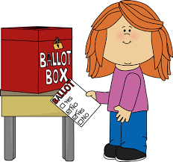
History
The Ladybug Picture Book Award was one of the first programs started by the Center of the Book at the New Hampshire State Library in 2003.
This award promotes awareness and appreciation of the best in recent children’s picture books.
It provides a wonderful opportunity for New Hampshire Librarians to introduce children and adults to the rich read-aloud world of literature and art. The award also introduces children to voting, one of the greatest American rights here in the First in the Nation New Hampshire.
http://nhbookcenter.blogspot.com/
https://www.nh.gov/nhsl/bookcenter/programs/ladybug.html
Notes:
Why the ladybug? It is the state insect
Indiana-Firefly award

Slide 4
The Committee & Timeline
The committee is mix of public and school librarians from around the state.
JAN/FEB: Picture book nominations are made and 10 final books selected.
MARCH: Final 10 nominees are announced.
NOVEMBER:Voting--New Hampshire children from preschoolers to third grade choose the winner. It is highly recommended that public librarians work closely with their local school librarians in holding voting events to prevent double voting.
Votes are tallied and the winning book is announced at the END OF THE YEAR.
Notes:
Homeschoolers, preschools

Slide 5
Selection
To be considered for nomination the book must:
Voting:
be published, in its current edition, within the last three years
be in print
have an author and illustrator both residing in the United States
possess strong child appeal
have artistic quality with text that supports the illustrations
not be a title previously nominated
Anywhere in New Hampshire with eligible voting aged children (up to 3rd graders)
All nominated books for that year were available to the voters.

Slide 6
Notes:
Pause at :53--can you think of a character from a Ladybug book you could relate to?
Examples of books she is describing

Slide 7
How can Public Libraries Get Involved?
Hold a series of evening programs for parents. Make it a family event.
Have resource sheets available for parents/caregivers to use at home.
Hold “Art of the Picture Book” workshops for primary teachers.
WORK WITH your school librarians and teachers to coordinate your efforts.
Purchase a complete set of the Ladybug Book Award nominees.
Use the books in storytimes.
Booktalk them to homeschool groups.
Read a-loud lunches at the school.
Special afterschool storytimes for younger students. Perhaps older students could help with reading?
Share in outreach to daycares and Headstart.
Advertise the book award with a special display.

Slide 8
Resources
Book Guides
Ballots
Stickers
Complete Guide
The guides for each of the ten nominations will be released one per week on the Book Notes blog prior to the beginning of school
Picture ballot, printable tally sheet and online tally forms available at the NH Book Center site
Order form to purchase voting and book stickers also available to the NH Book Center site
The complete voting guide with all the book guides together will be released after each book has appeared on the blog
Notes:
https://www.nh.gov/nhsl/bookcenter/programs/documents/sticker_order_form.pdf
https://www.nh.gov/nhsl/bookcenter/programs/ladybug.html
http://nhbookcenter.blogspot.com/

Slide 9
Online Resources
Center for the Book at the New Hampshire State Library:
https://www.nh.gov/nhsl/bookcenter/programs/ladybug.html
Book Notes NH:
http://nhbookcenter.blogspot.com/
Ladybug sticker order form:
https://www.nh.gov/nhsl/bookcenter/programs/documents/sticker_order_form.pdf
NH State Library - Youth & Adult Services Blog:
http://nhlibraries.org/youthservices/

Slide 10
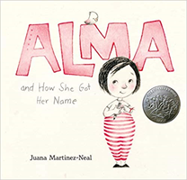
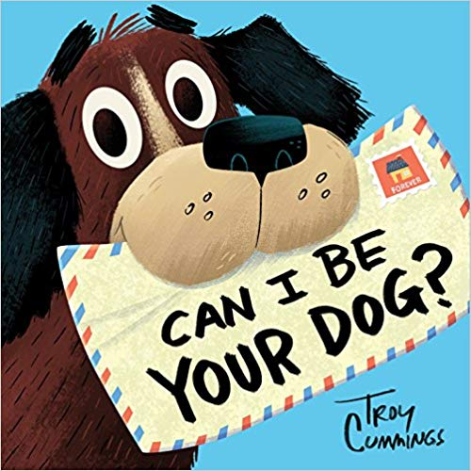
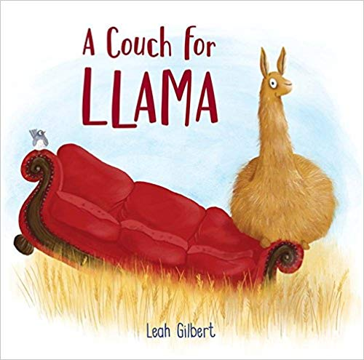
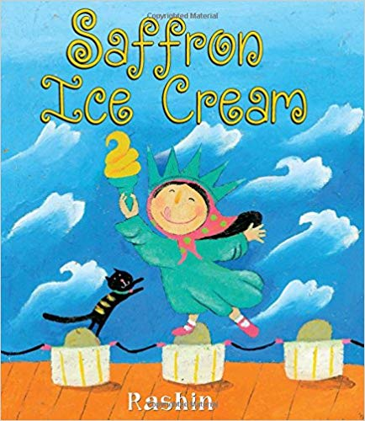
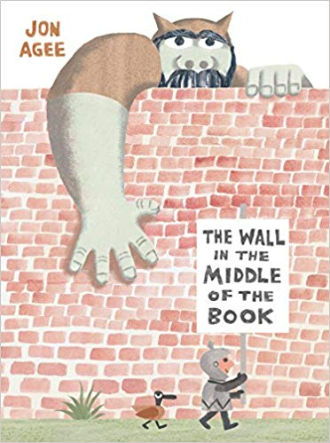
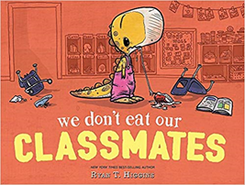
The Nominees for 2019 are...

Slide 11
Supercharge your Storytimes!
“Librarians and educators need to embrace every opportunity to make the most of their informal learning environments. Working with early literacy concepts can increase your contributions to strengthening a child’s neural connections, ensuring you make the most of the time you spend with your storytime attendees.” ~ Early Learning that Work Successfully (VIEWS2)
Eight early literacy concepts
Alphabetic Knowledge: Exploring with Letters
Communication: How to Talk & Share
Comprehension: Understanding Stories, etc.
Language Use: How to Use Words
Phonological Awareness: Playing with Sounds
Print Concepts: Connecting with Stories
Vocabulary: Understanding & Using Words
Writing Concepts: Writing
http://views2.ischool.uw.edu/resources/

Slide 12
“Your practice will be powerful and effective when, by using the VIEWS2 Planning Tool, you purposefully incorporate the early literacy skills from the VIEWS2 domains into the five practices of ECRR2.” ~ VIEWS2 Research Team
VIEWS2
Domains
ECRR2
Practices
VIEWS 2 Planning Tool
Notes:
Typically public librarians will use picture books with much younger children than school.

Slide 13
NH Early Learning Standards provide a tool for early childhood professionals to use in understanding developmentally appropriate expectations of children in order to successfully transition from early childhood programs to elementary schools.
https://www.dhhs.nh.gov/dcyf/cdb/documents/nh-early-learning-standards.pdf
Reads closely to find main ideas and supporting details in a story
Retells familiar stories using beginning, middle, and end |  |  |  | Continues
Pretends to read a book or tell a story or during play |  |  | Continues | Continues
Enjoys being read to and talked to, focusing on the person speaking |  | Continues | Continues | Continues
 | Young Infants (0 to 11 months) | Ages 3 to 4 years | Age 5 and Kindergarten | 3rd Grade
Notes:
Support children in their early learning by using scaffolding
Show book-standards

Slide 14
Early Literacy Planning Tool Worksheet: This worksheet is a companion to the Early Literacy Planning Tool (ELPT). See the endnotes for directions on how to make use of it to be intentional about planning your storytimes.
ELPT Component: Writing
ELPT Goal: Children demonstrate alphabet knowledge
SEL Skill:
Storytime Age Level | Your Strategy | Children’s Behavior
B – 18 months | Ask children to point out words and pictures in book in order to prompt children to think about the differences between words and pictures | Point to words in a book
18 – 36 months | Asks children about attempts to produce written, age-appropriate materials. | Scribble and make marks on paper purposefully.
36 – 60 months | Incorporates drawing into storytime activities. Provides activities that encourage drawing basic geometric shapes Provides activities that encourage pretend writing | Begin to draw representational figures. Draws basic shapes. Use pretend writing activities to show print conventions in primary language
Storytime Item: (book, song, movement activity, flannel board, craft, etc.): Can I Be Your Dog? By Troy Cummings
Activity: (What you are doing with the item? How could you make it more interactive?):
*Pretending you are an animal, write a letter (or postcard) asking for a home? Younger children can dictate to an adult or older sibling and add pictures. *Draw a picture of the dog happy in his new home. *Draw a map of all the different places the dog wanted to live and retell the story with the map.
Tip to share with parents/caregivers:
Before children learn actual letters, they are aware of shapes.
Writing has a natural progression. Scribbles progress to letter-like shapes followed by actual letters. Provide opportunities for practice.
Notes:
Why is writing important in storytime? It teaches children that print has meaning, letters represent sounds and written words = oral words.
Writing can be integrated into craft activities.
Finger plays are perfect to help develop children’s fine motor skills and pincer grasp.

Slide 15
Self-Awareness | Self-Management | Social Awareness | Relationship Skills | Responsible Decision-Making
Identifying emotions Accurate Self-perception Recognizing strengths Self-confidence Self-efficacy Growth mindset Optimism | Emotional regulation Impulse control Stress management Self-discipline Self-motivation Goal-setting Organizational skills | Perspective-taking Attend to body language, tone, etc. Empathy Appreciating diversity Respect for others | Communication Social engagement Cooperation Relationship-building Teamwork | Identifying problems Analyzing situations Solving problems Evaluating Reflecting Ethical responsibility Make good learning choices
From: Teaching SEL in Daily Academics By: Mike Anderson
Notes:
Social Emotional Learning Skills. Although children's picturebooks have always been used to support young children's reading skills, and although they are slowly being recognized as powerful implements for visual literacy, they have been largely neglected as a path toward children's emotional development.
Example:Empathy, that is, the ability to understand other people's emotions, is arguably the most important capacity that distinguishes human beings from other living organisms. However, this capacity does not appear automatically; it normally emerges at the age of 4 and develops gradually toward adolescence. Empathy typically develops more slowly or even is totally impeded in children with various forms of autism. Yet like all other literacies, emotional literacy can be enhanced and trained using picture books.
SEL SKILL for Can I Be Your Dog? Talk with your neighbor for a few minutes

Slide 16
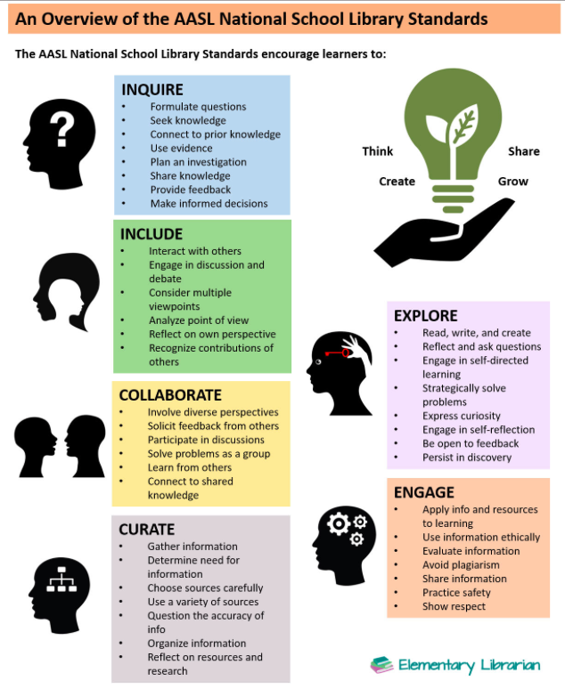
Can you find connections to the AASL National School Library Standards?
How could you work with your school librarian to coordinate a Ladybug Award project?

Slide 17
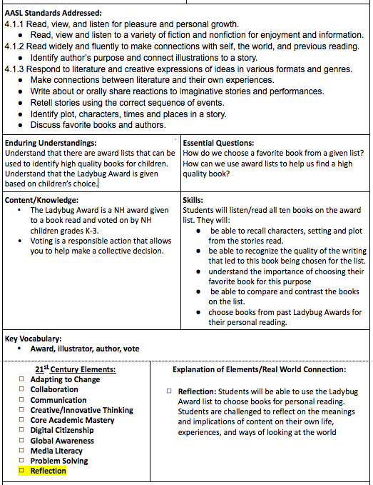
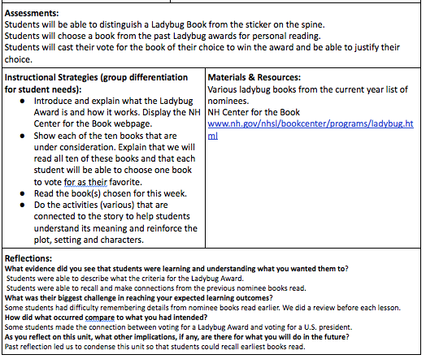
Sample Master Lesson Plan

Slide 18
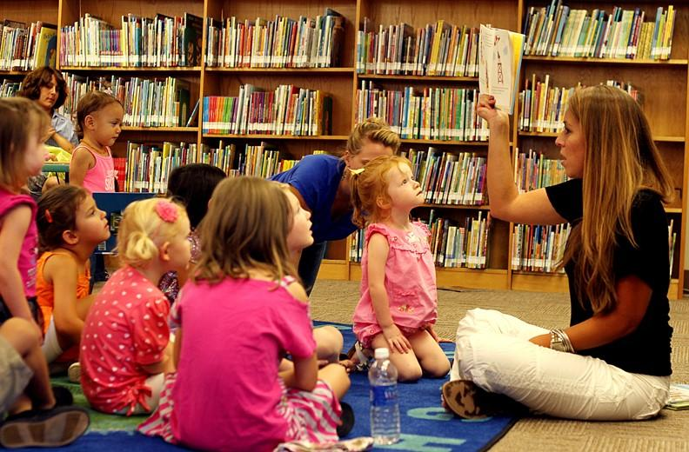
It doesn’t matter if you are using the terms from ECRR, VIEWS2, AASL or the NH Early Learning Standards it is about your INTENTIONALITY in connecting storytimes to early literacy behaviors.
http://www.earlylit.net/ Saroj Ghoting

Slide 19
Discussion for ANY picture book
Introduce these great vocabulary words in your picture book discussions:
What is the genre of this book and what is it about the story or pictures that supports that idea?
Where does the story take place or what is the setting? Is there more than one setting? Does the story take place in the past, now or in the future? How much time goes by in the story?
What is the plot? What is the problem and if it is solved--when and how.
Who is the narrator of the story? How would the story change if the author had chosen a different person to be the narrator?
Talk about the characters. Who is the main character and how can you tell?
What is the overall message of the story? Can you associate it with something in your life or something happening in the world?

Slide 20
Integrating Technology Into Your Program
Watch author interviews, illustration demos and read-alouds.
Research author/illustrator websites.
Have students write and record a booktalk.
Use QR codes to have readers access the booktalk.
View clips of live animals (example: watch a real Inky)
Create artwork and/or slideshows (think sequencing) using apps like Doodle Buddy or Draw Free for iPad.
Create ebooks using Storykit or Creative Book Builder.
Animate with Toontastic.
Review the books by creating a game like Jeopardy at www.superteachertools.com
Notes:
Watch video if there is time.
Preview websites and videos--not all content is young child friendly.

Slide 21
Teaching kids about voting
How to make an informed decision
Advocate for your choice
Teach respectful disagreement
Use math to explain results
Make it fun--Hold a voting party!

Slide 22
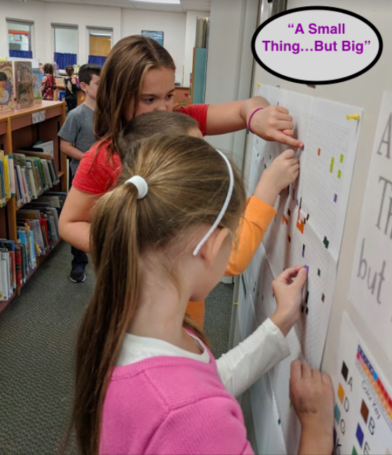
“A Small Thing...But Big”
https://www.letsticktogether.com
Students were given stickers after each book was read to add to the mosaic.

Slide 23
Sample Activities
for
Inky’s Amazing Escape
by Sy Montgomery
Examples of how one book can be used for many subjects
Creatures of the Sea In a Scramble
Art: How to Draw an Octopus
Science: No Bones About It
Research: Nat Geo Kids - All About the Octopus
Video of Octopus Escaping

Slide 24
Thank you for attending our presentation!
Karen and Deb

