Slide 1
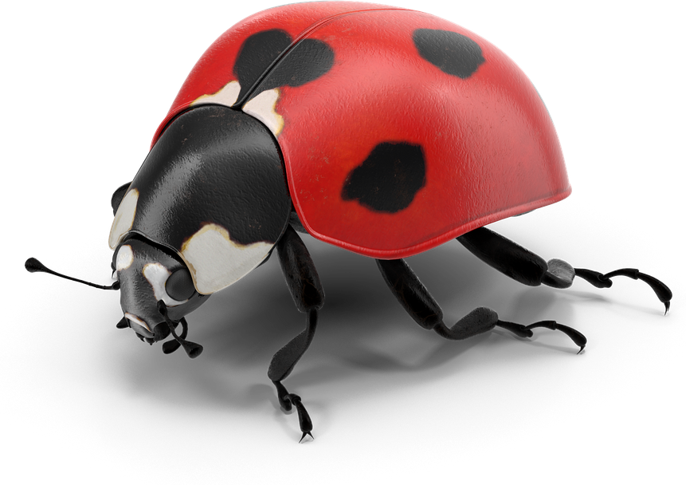
NH Ladybug Picture Book Award
HOME SCAVENGER HUNT
2020

Slide 2
Before We Start
Things to note:
Do NOT leave the house during the search.

Slide 3
Things to note:
Please do NOT take something your grown-ups wouldn't want you to.

Slide 4
Things to note:
You may NOT take anything breakable, fragile or valuable--even if you think your grownups would be ok with it.

Slide 5
Things to note:
I will say the name of the book, the object and then GO!

Slide 6
Things to note:
Do NOT leave before the word "GO" or you are disqualified.

Slide 7
Things to note:
Find the item, bring it back and hold it up to the screen.

Slide 8
Notes:
Object: Something round like a bicycle tire.

Slide 9
Notes:
Object: Something Pink like Crunch

Slide 10
Notes:
Object: Something with numbers on it.

Slide 11
Notes:
Object: Something brown like Fry Bread.

Slide 12
Notes:
Object: Something made of or looks like wood.

Slide 13
Notes:
Object: Something that starts with the S sound like Saturday.

Slide 14
Notes:
Object: Something fluffy, furry or soft like Sheep Dog or Sheep Sheep

Slide 15
Notes:
Object: Something that reminds you of the beautiful night sky.

Slide 16
Winner!
Notes:
Object: Something you can eat.

Slide 17
Notes:
Object: Something that looks like an animal you might have as a pet.

Slide 18
THANK YOU FOR PLAYING!
I hope you had fun!
Thank you to Kary Henry (Ms. Kary-Deerfield Public Library) for sharing her Literary Scavenger Hunt on the ALSC blog Dec 30, 2020 and inspiring this scavenger hunt.

